Slide 1
Ow, My Knee!
By,
Arun Jayakumar, Deep Nakum, Pepe Yankholmes, Nitin Mali

Slide 2
Patient Profile
Name: Gregory Murphy
Nationality: Irish-American
Age: 64
Height: 5’10”
Weight: 190lb
3 Children: Abigail, Catrina, Patricia
Medicare Beneficiary

Slide 3
Patient Profile (cont’d)
Gregory has 3 daughters who live in separate states. He would like to move to a location close to his family, however it is not a significant preference.
Abigail Smith
Age: 32
Residence: Los Angeles, California
Catrina McDaniels
Age: 30
Residence: Milwaukee, Wisconsin
Patricia Murphy
Age: 27
Residence: Stowe, VT

Slide 4
Health Notes
Former Job: Construction Worker (soon to be retired)
Recently Diagnosed with Arthritis
Predisposed to Diabetes
Used to play basketball in high school and college
Tore ACL in college and was forced to retire from sports
Uses Tylenol for Arthritis pain resulting from his ACL injury.
Broke ankle bone and sustained hairline fracture in foot during ACL injury

Slide 5
Gregory’s Story
Gregory is nearing retirement age and would like to move to a new area that can provide affordable benefits at a reasonable price through Medicare. His preferences of living choices includes living by other Irish-Americans, and having a male doctor. He does not have a car, therefore living in a big city would allow him to commute to the doctors office easily. He is looking to move by January 1, 2016.

Slide 6
Gregory’s Dilemma
On December 15, 2015, Gregory fell down the stairs and reinjured his knee. His apartment lease is set to expire on December 31, 2015. There are two issues with Gregory's situation:
He is required to move by January 1, 2016. He has not decided where to move yet.
He needs to look for a doctor in his new location that can treat his knee injuries in the future.

Slide 7
We analyzed the CMS Utilization and Market Saturation Tool to help Gregory find a solution to his problem.
We are trying to find a solution for a real patient who is trying to relocate and helping him find real set of doctors is a big task.
Using StatTools, Excel, Rstudio, and Tableau we were able to find answer to both of Gregory’s issues.

Slide 8
Assumptions
Assumption #1: The higher number of beneficiaries indicates a high quality of service
Assumption #2: Submitted Charge – Standardized Medicare Payment = Out-Of-Pocket Deductible
Assumption #3: We are looking specifically at the doctors with a higher number of beneficiaries that are paying less out-of-pocket deductible for more services.

Slide 9
Problem #1: Finding a New Home
Trimmed Dataset from 1.02m Rows to 178k Rows by filtering data by Country Code, State Code, Gender of Physician, and Medicare Participant Indicator.
We looked at physicians based in the top 10 states with a high Irish-American population, along with physicians based in the states that Greg's daughters live in (source listed In "sources" tab).

Slide 10
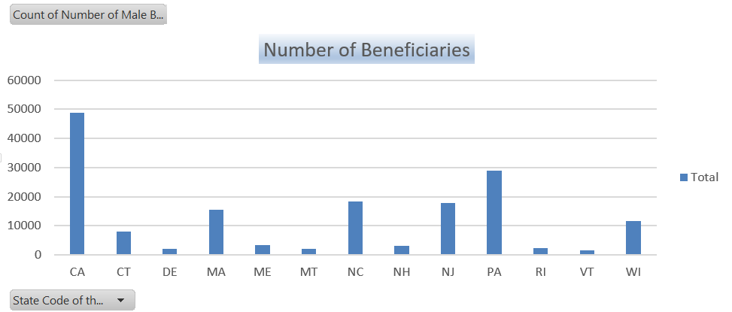
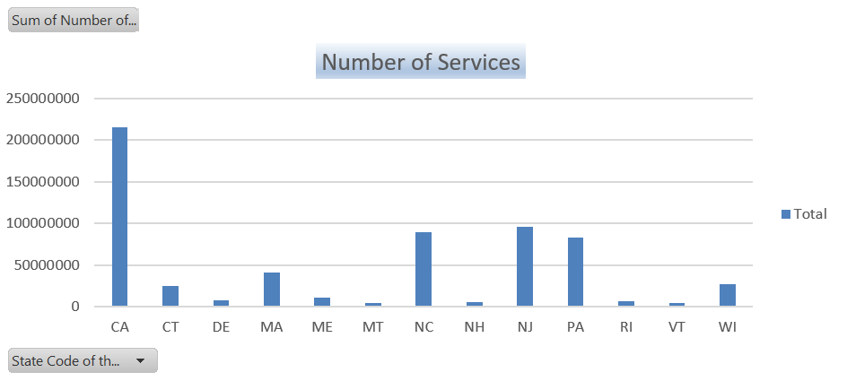
CA has got highest number of Male Beneficiaries and Highest Number of Services

Slide 11
How did we do?
Based on stat analysis of the data set we get too many summary which might help us in consolidating the data.
We started with dumping the data in excel. We used Pivot table and charts.
Consolidated data based on stat analysis(stat tools).
Uploaded data into Tableau and R studio.
Applied Machine learning technique to decide few parameters for recommendation.
Plotted Various graphs to visualize different combinations of discrete and continuous data, comparing different fields and measures to identify trends and correlations

Slide 12
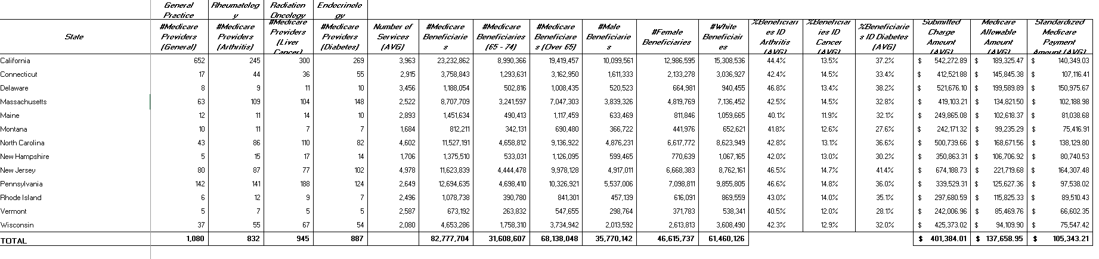
Statistic Analysis of the data set state wise

Slide 13
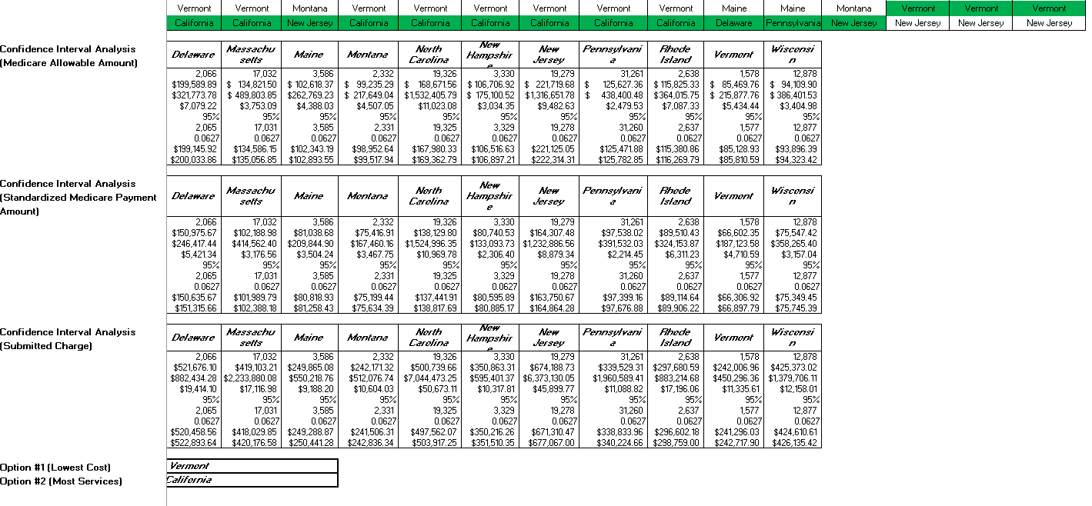

Slide 15
Problem #1: Finding a New Home

Slide 16
Problem #2: Finding the Right Doctor

Slide 17
Problem #2: Finding the Right Doctor

Slide 18
Problem #2: Finding the Right Doctor

Slide 19
Problem #2: Finding the Right Doctor

Slide 20
Conclusion
1) After analyzing the data, we have concluded that Gregory should live in Los Angeles, CA.
2) We can conclude that Gregory’s best doctor options are:
Rheumatology:
Dr. Yongchul Huh
356 South Western Ave, Los Angeles, CA 90020
Dr. Jae Jung
100 UCLA Medical Plaza, Los Angeles, CA 90024
Dr. Raymond Hah
1450 San Pablo Street, Los Angeles, CA 90033
Orthopedic Surgery
Dr. Hyung Shin
1300 North Vermont Ave, Los Angeles, CA 90027

